Slide 1
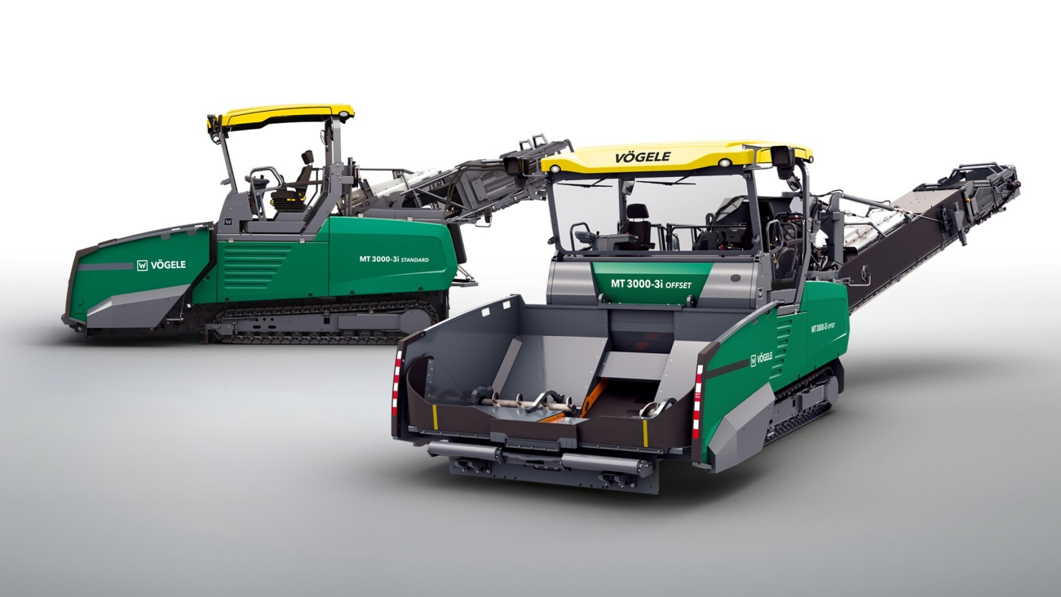
MT 3000-3(i) PowerFeeder

Slide 2
MT 3000-3(i) Standard and Offset
Two machines - one concept
  MT 3000-3(i) Standard
  material feeder with short, rigid conveyor
  MT 3000-3(i) Offset
  material feeder with long, pivoting conveyor

Slide 3
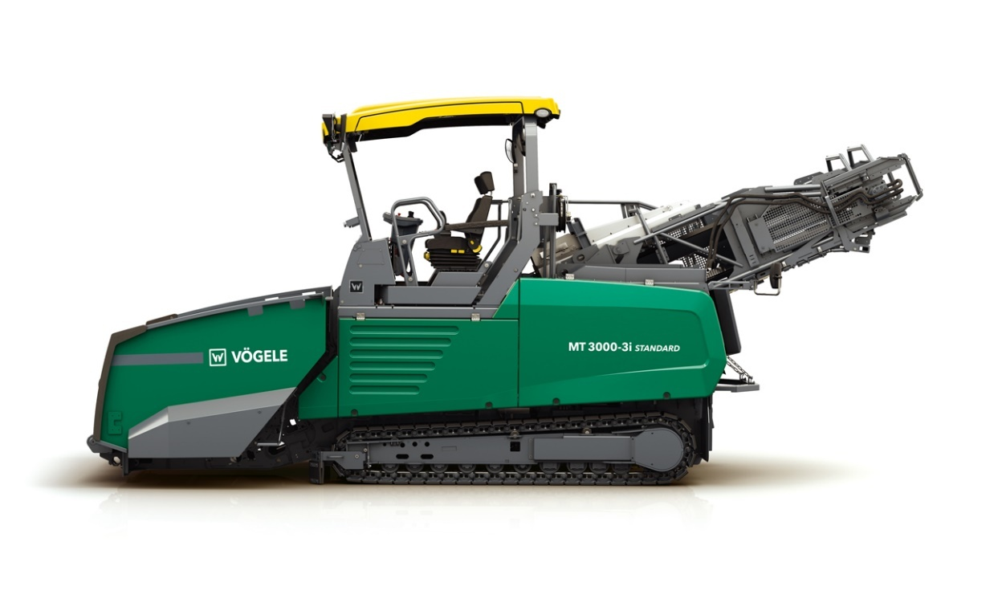
MT 3000-3(i) Standard
  Classic material feed process for large quantities of mix
  Uninterrupted supply of mix
  Paving process without pauses
  For large road construction projects
    Rehabilitation of major roads
    Paving large widths
    Large layer thicknesses

Slide 4
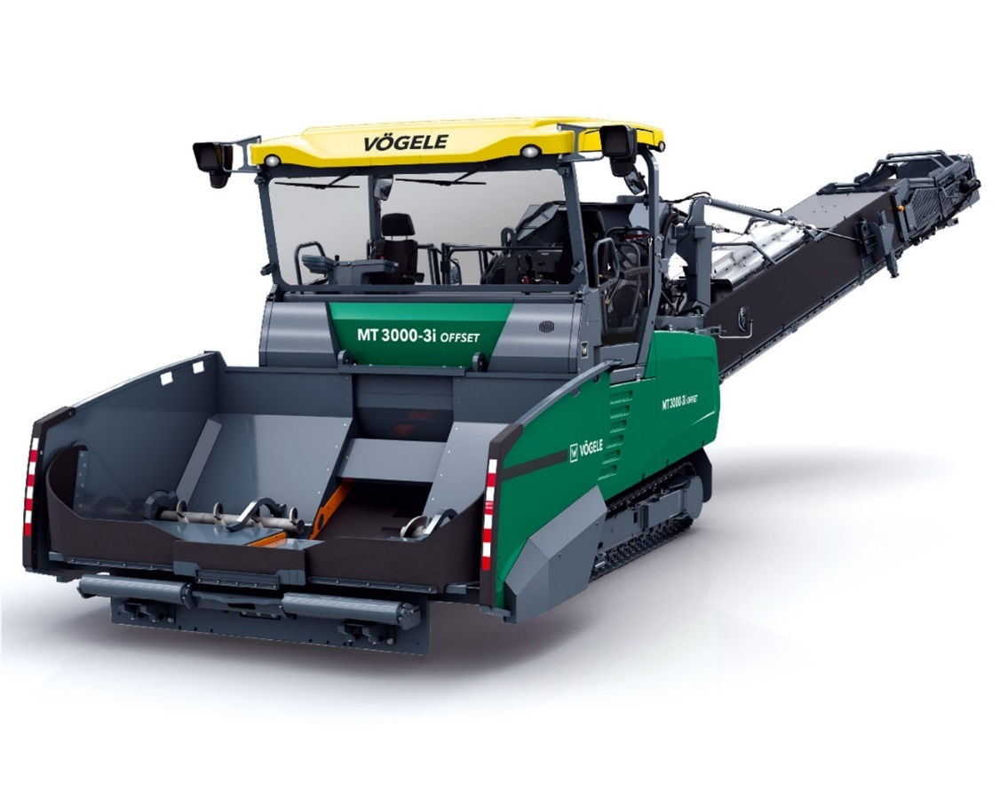
MT 3000-3(i) Offset
  Uninterrupted, contact-free supply of mix
  Broad range of applications
    Classic material feed process
    Feeding from the side
    Material feed process for working “hot to hot”
    Feeding pavers in an
    InLine Pave train

Slide 5
Highlights
  The new generation of material feeders
  Modern drive concept
  Redesigned receiving hopper
  Optimized conveying of mix
  Optimized belt heating
  ErgoPlus 3
  AutoSet Plus
  PaveDock Assistant
  New maintenance and service concept

Slide 6
Modern drive concept

Slide 7
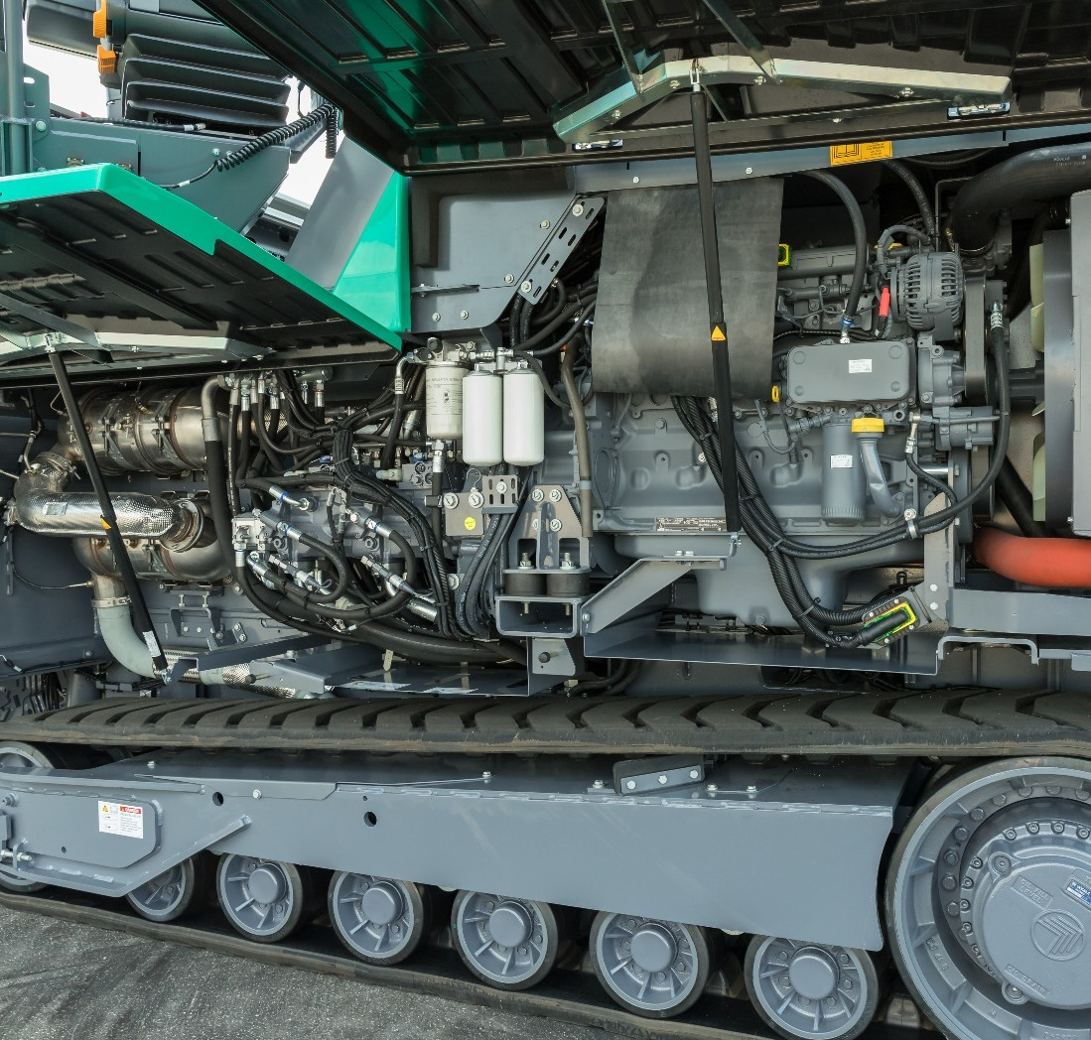
Modern drive concept – MT 3000-3
High conveying capacity with quiet, economical operation
  Engine: Deutz TCD 2012
  Output:
    Nominal output: 142 kW at 2,000 rpm
    ECO Mode: 134 kW at 1,800 rpm
  Exhaust emissions standards:
    European exhaust emissions standard Stage 3a
    US standard EPA Tier 3
  Fuel tank: 450 litres

Slide 8
Modern drive concept – MT 3000-3i
High conveying capacity with quiet, economical operation
  Engine: Deutz TCD 6.1
  Output:
    Nominal output: 160 kW at 2,000 rpm
    ECO Mode: 152 kW at 1,800 rpm
  Exhaust emissions standards:
    European exhaust emissions standard Stage V
    US standard EPA Tier 4f
  Fuel tank: 450 litres

Slide 9
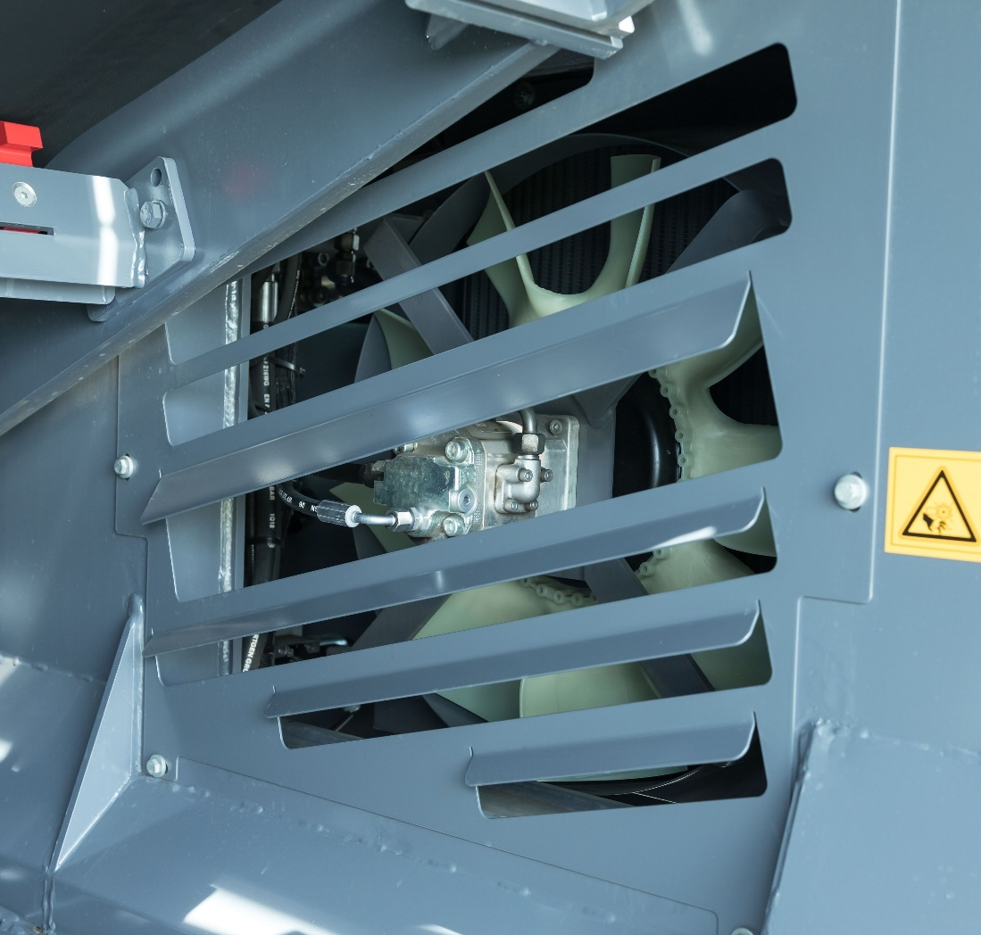
Modern drive concept
Controlled hydraulic oil cooler
  The controlled hydraulic oil cooler significantly reduces noise emissions
  Hydraulic engine with integrated speed sensor and electric proportional adjustment

Slide 10
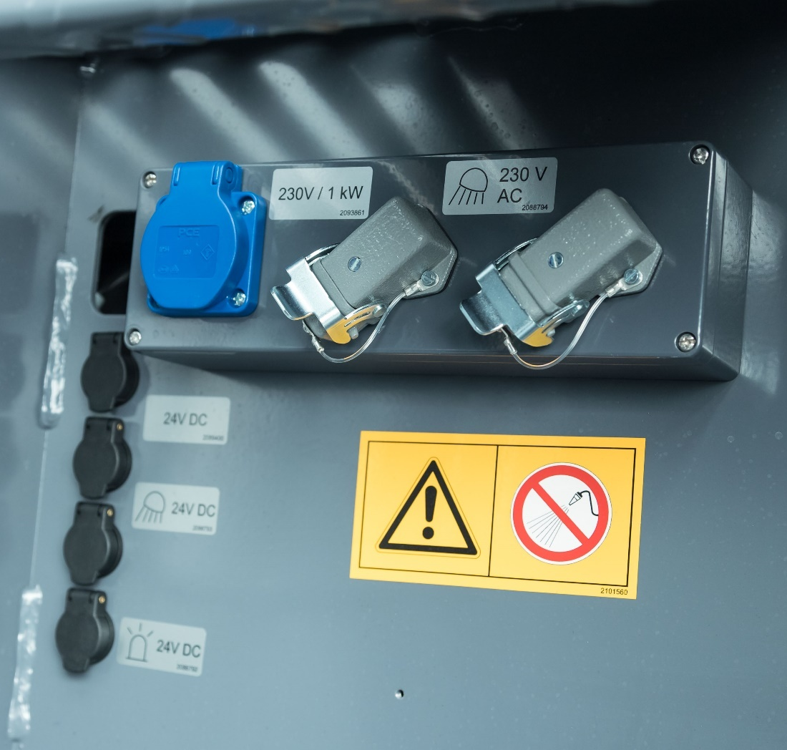
Modern drive concept
Electrical package with 230 V
  Hydraulically-driven three-phase AC generator
  Socket (earthed) plus two connections for light balloons
  Heating for the belt scraper

Slide 11
Redesigned receiving hopper

Slide 12
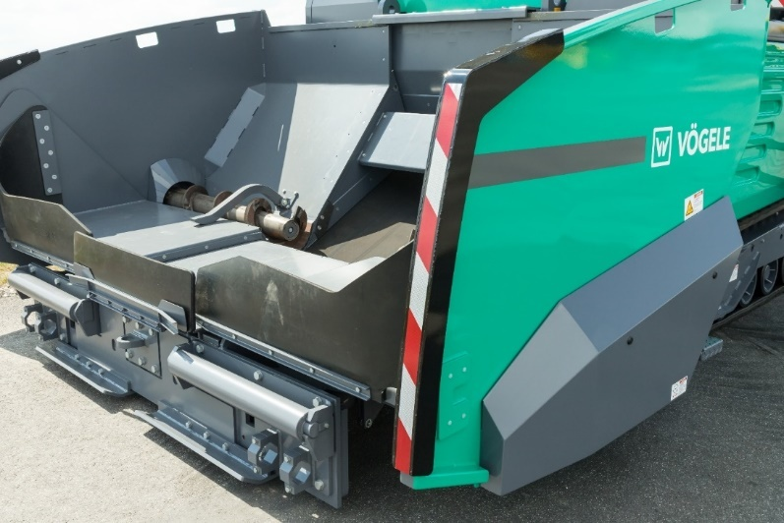
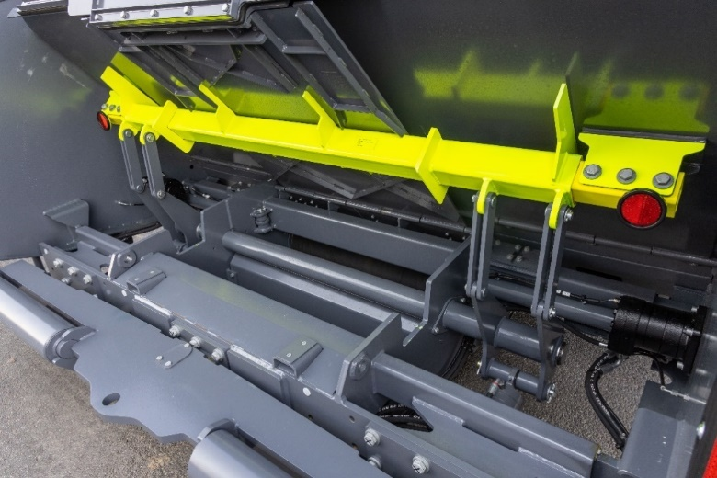
Redesigned receiving hopper
New receiving hopper geometry
  Highlighted hopper sides
  Raised hopper floor marked in colour
  Outer ends of push-roller marked in colour

Slide 13
Optimized conveying of mix

Slide 14
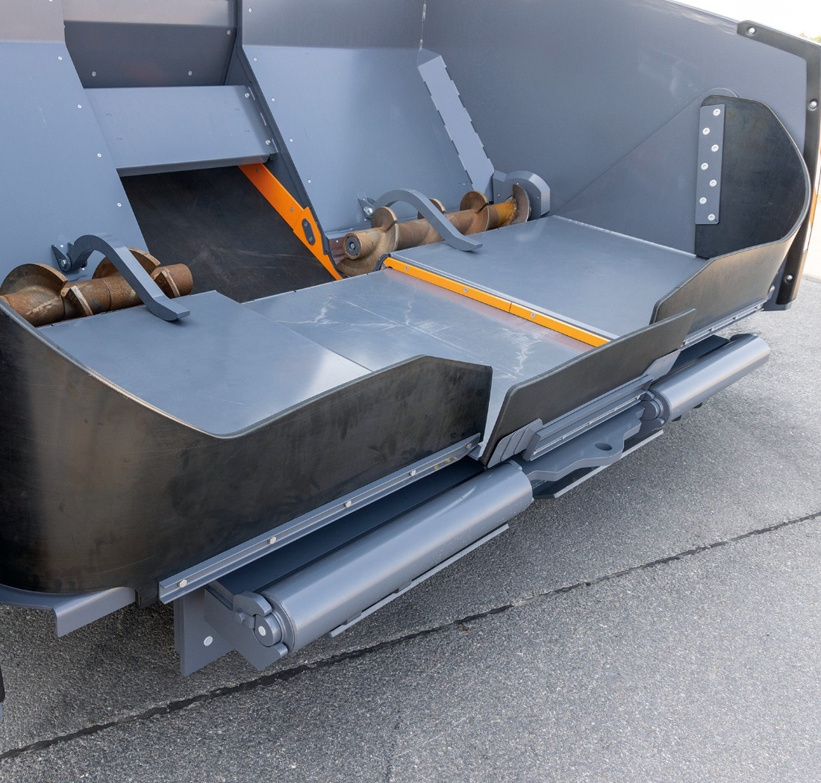
Optimized conveying of mix
Modified receiving area
  Rapid, loss-free receiving and conveying of a complete truckload
  Cylindrical augers with optimized auger protection
  Inlet area behind the deflection drum
  Inlet area sealed off to prevent contamination inside conveyor
  Option: conical augers homogenize the mix perfectly

Slide 15
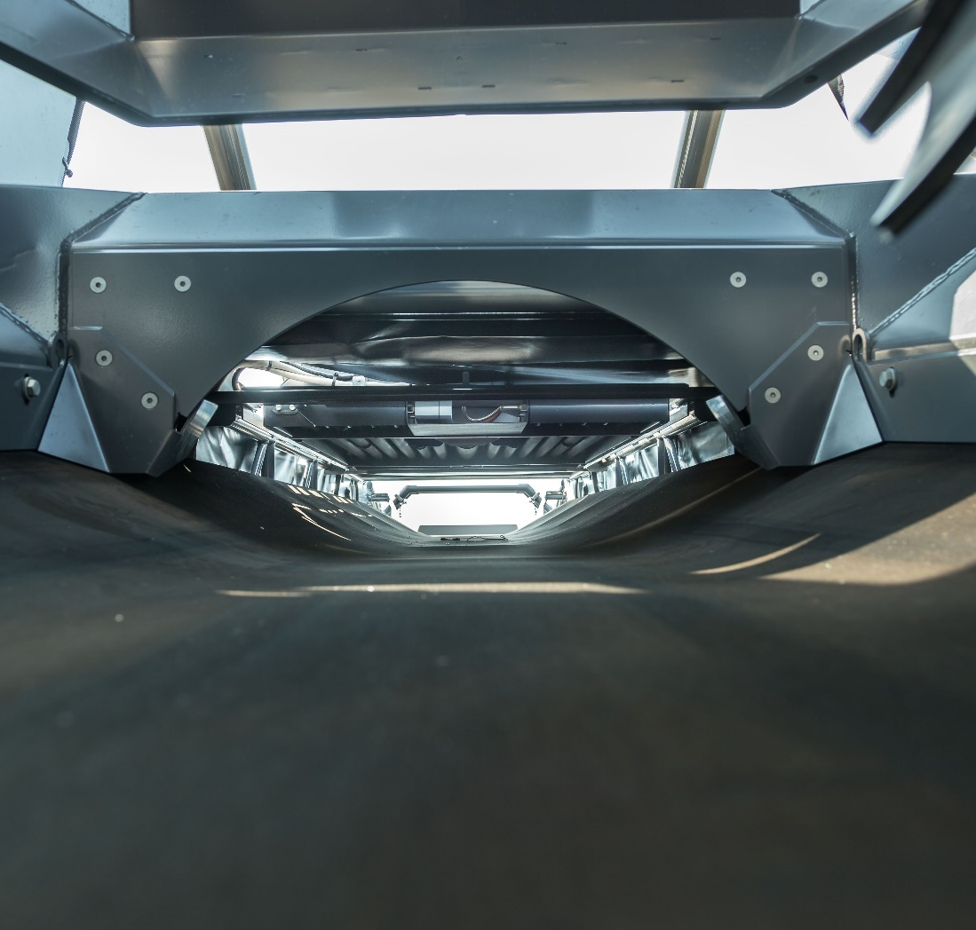
Optimized conveying of mix
Perfect belt running
  Improved belt guidance keeps the conveyor belt permanently centred
  Conveyor belt is centred even under difficult conditions of use such as transverse slopes
  Lateral buffer rollers stop the conveyor belt chafing on the frame
  No loss of material and reduced wear

Slide 16
Optimized belt heating

Slide 17
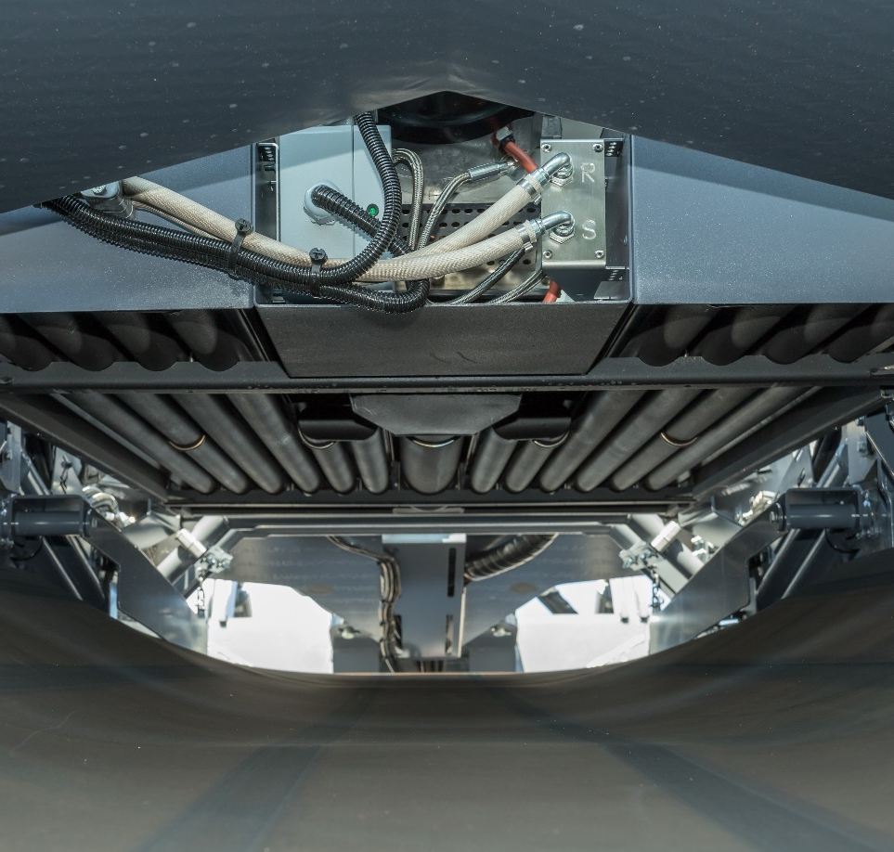
Optimized belt heating
New belt heating control
  Significantly reduces fuel consumption
  Reliably maintains mix at the correct temperature
  Reduces adherence of mix to the conveyor belt
  Allows the handling of critical mixes such as low-temperature asphalt

Slide 18
ErgoPlus 3 operating concept

Slide 19
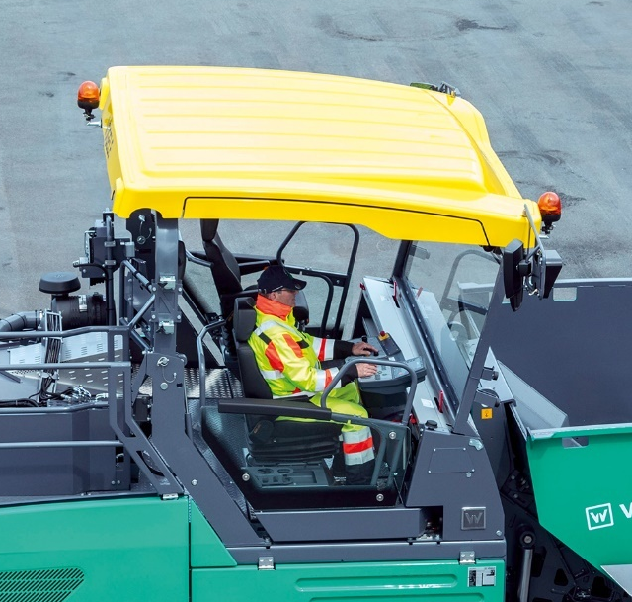
ErgoPlus 3 operating concept
Convenient, ergonomic, safe and simple
  ErgoPlus 3 makes humans the focus
  Machine simple and intuitive to operate
  Ergonomic and safe workplace for the operator
  Full control of machine and project

Slide 20
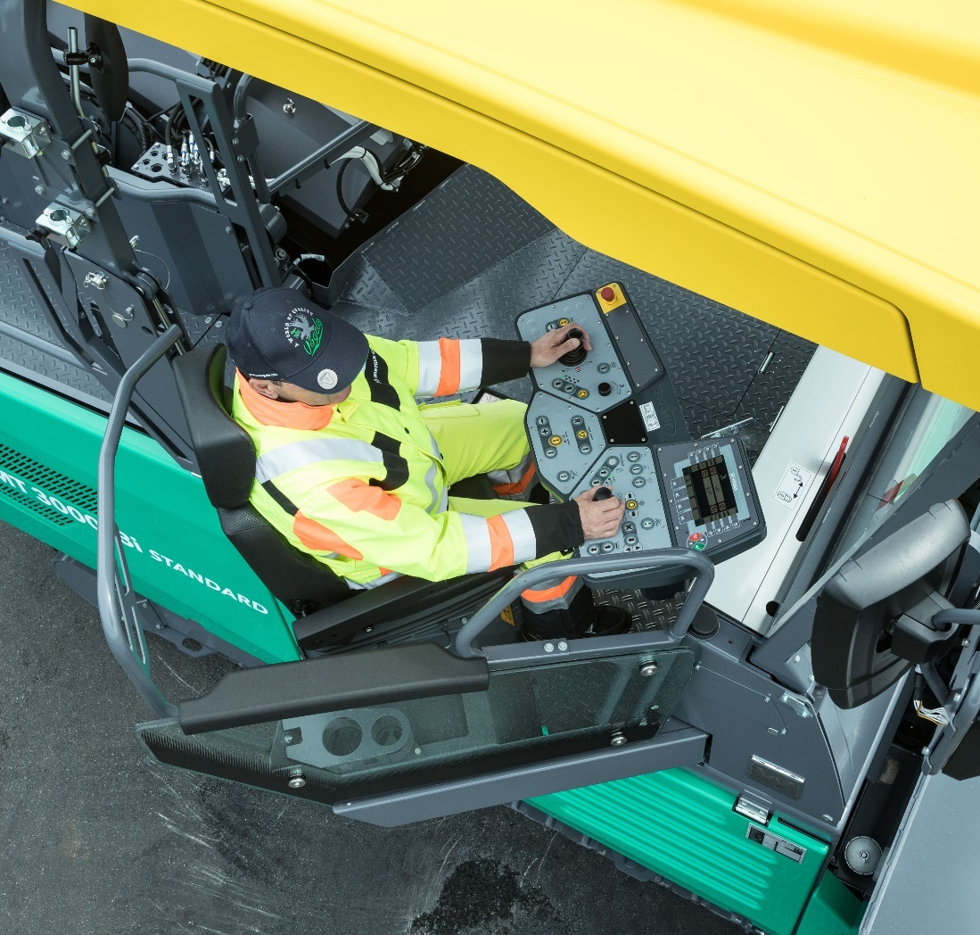
ErgoPlus 3 operator’s platform
Convenient, clear and comfortable
  Good all-round visibility
  Plenty of stowage space
  No edges to trip over
  Protection from wind and rain
  Swivelling operator’s seat
  Weather protection on the sides for greater comfort during operation

Slide 21
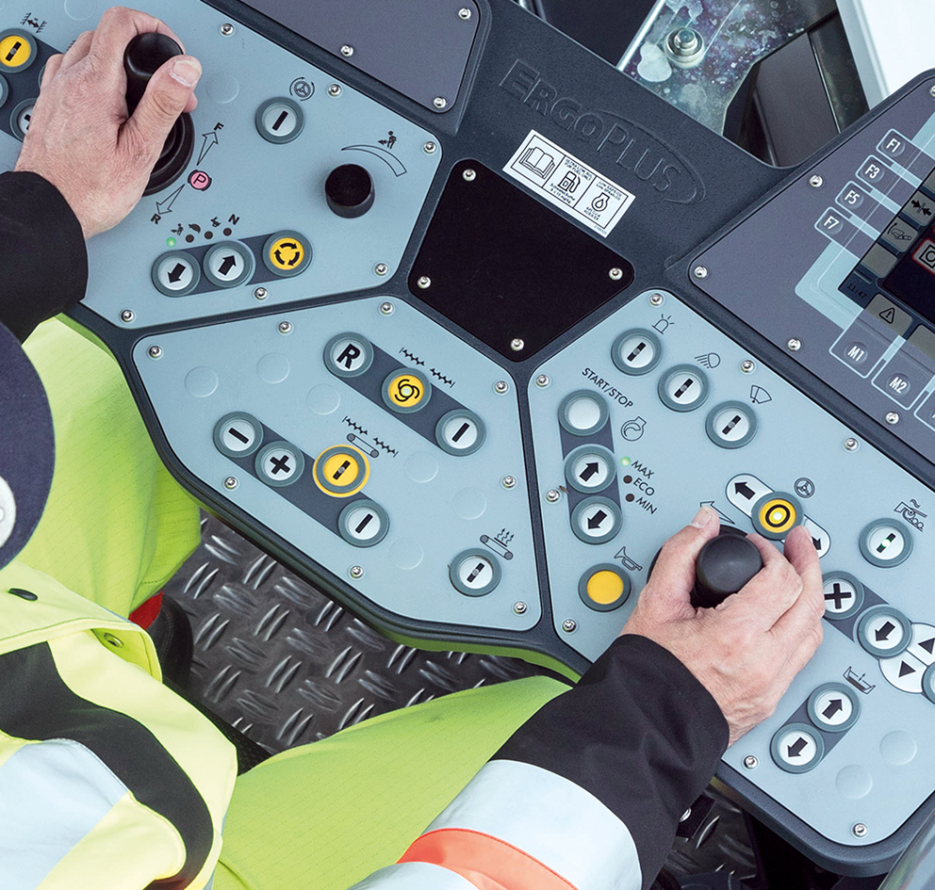
ErgoPlus 3 operator’s console
Logical, practical and intuitive
  Functions in logical groups
  Touch and Work functions are executed directly without repeat confirmation
  Automatic background lighting
  Based on the ErgoPlus 3 operating system for pavers

Slide 22
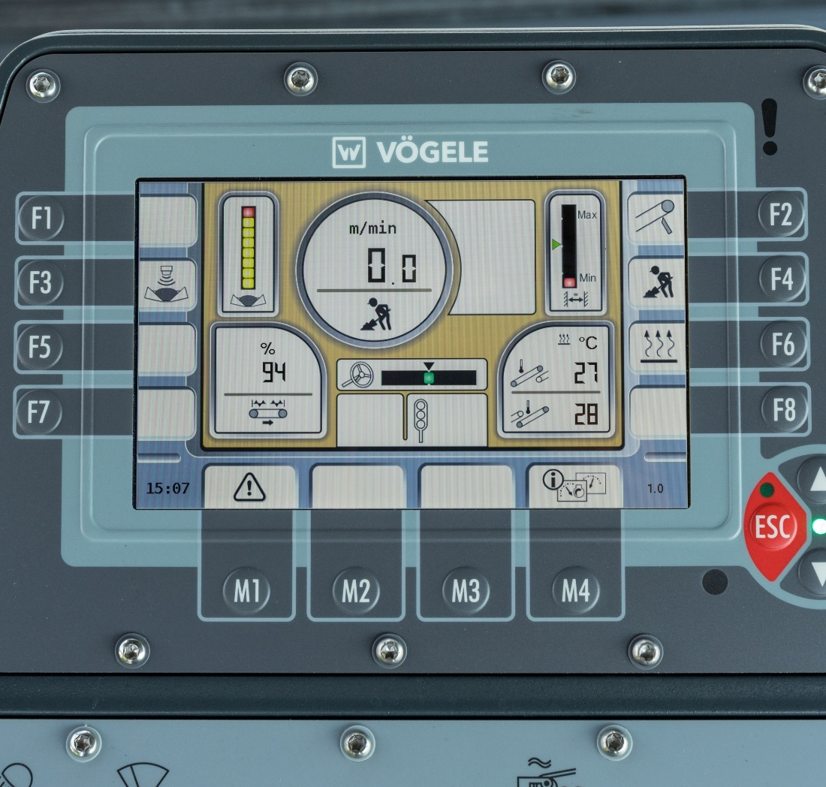
ErgoPlus 3 operator’s console – display
  Simple menu structure
  Optimized operating logic prevents faulty operation
  Various process situations displayed
  New, logical arrangement of symbols
  Reduced settings

Slide 23
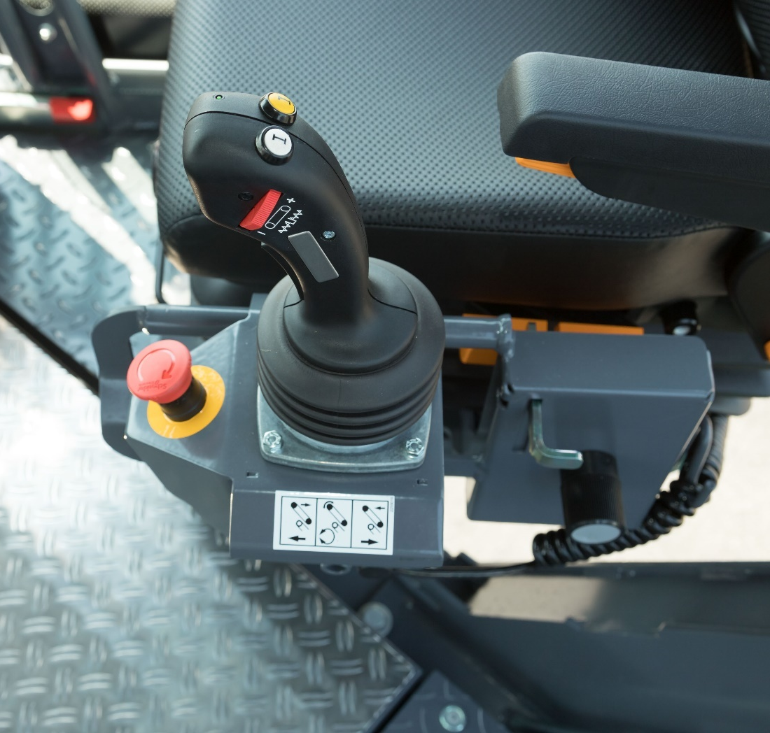
ErgoPlus 3 – joystick for Offset
Simple operation of the pivoting conveyor
  Raise/lower conveyor
  Rotate conveyor
  Speed of conveying process
  Conveying process, automatic mode
  Conveying process, manual mode
  Second joystick available as an option
  Can simply be detached and stowed

Slide 24
AutoSet Plus

Slide 25
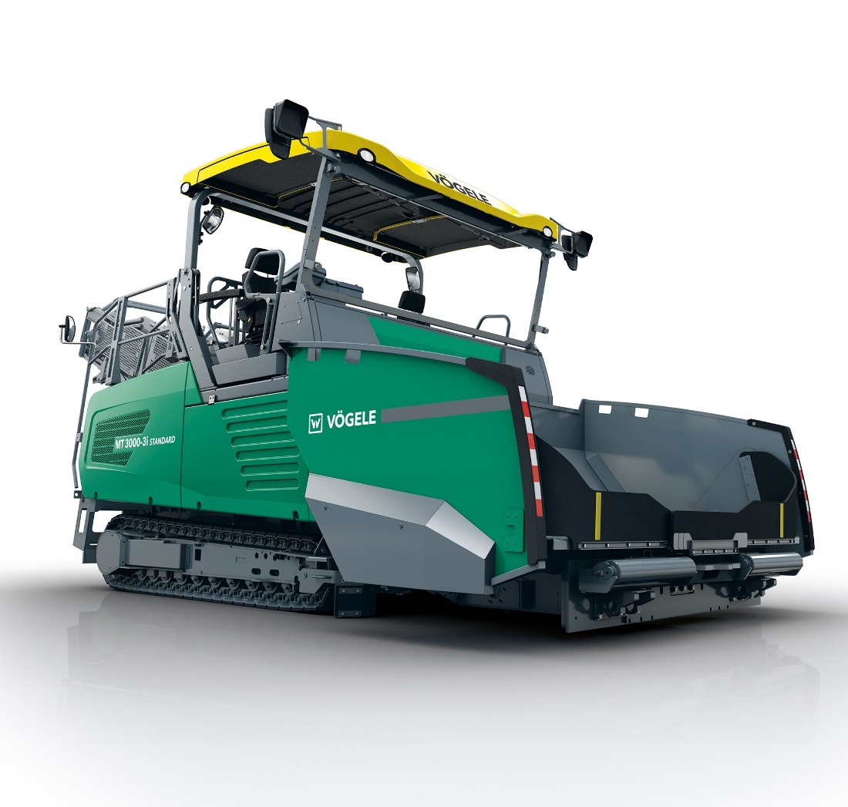
AutoSet Plus
Repositioning functions
  For job sites involving frequent repositioning and for transport
  Conveying programs
  Conveying programs which are predefined and can be saved individually

Slide 26
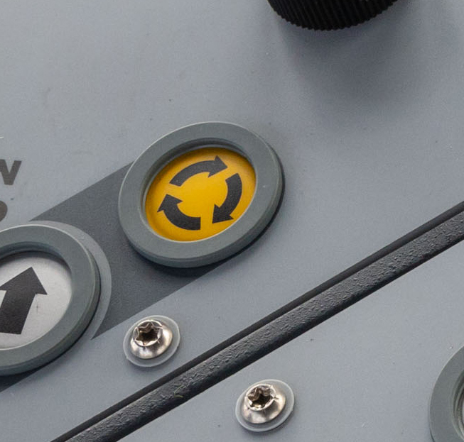
AutoSet Plus - repositioning functions
Can be repositioned quickly and easily
  In repositioning or transport position at the touch of a button:
    deflector
    pivoting conveyor boom
    material hopper
    hopper side
  Everything returned to the saved operating position at the touch of a button

Slide 27
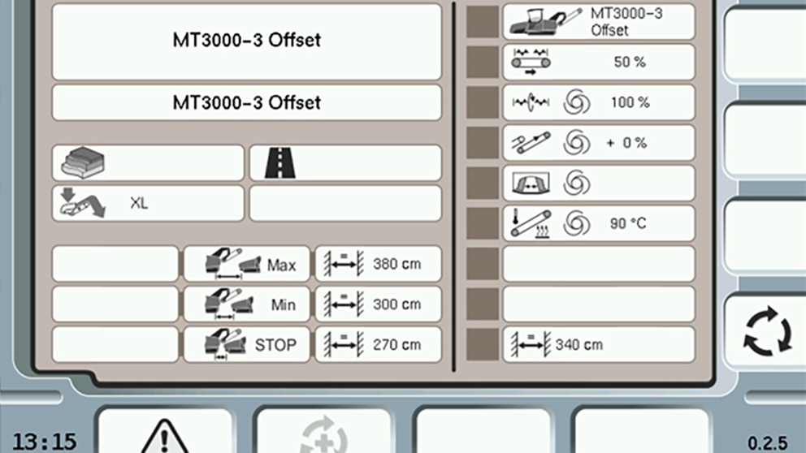
AutoSet Plus - conveying programs
Save simply and intuitively
  Predefined programs for low, moderate and high conveying capacity
  Conveying programs can be saved individually
  Saved parameters:
    settings for conveyors and augers
    belt heating
    distance from paver

Slide 28
PaveDock Assistant

Slide 29
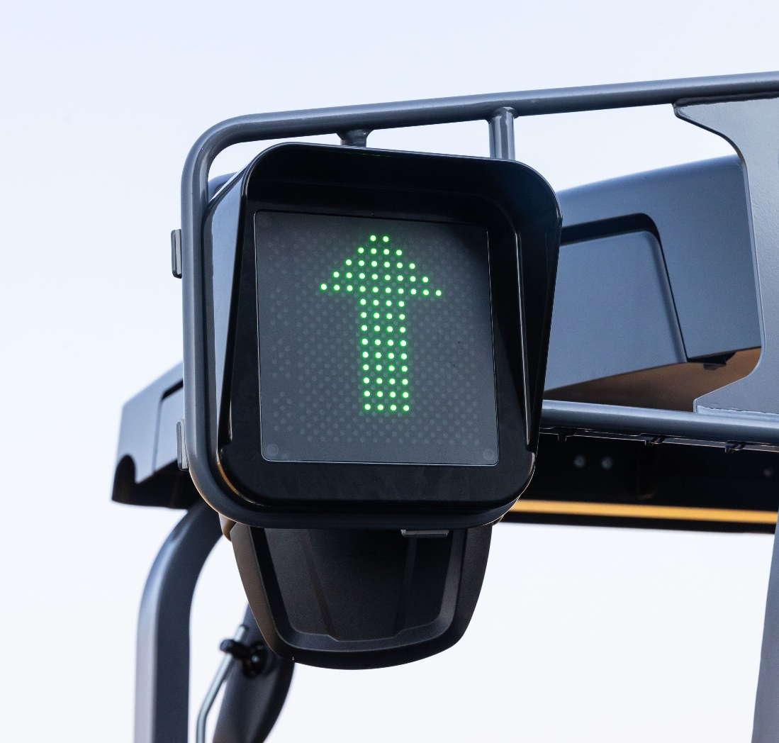
PaveDock Assistant
Straightforward communication between material feeder operator and truck
  Two signal lights tell the truck driver:
    to drive off
    to stop
    to dump mix
  Makes material transfer safe, loss-free and efficient

Slide 30
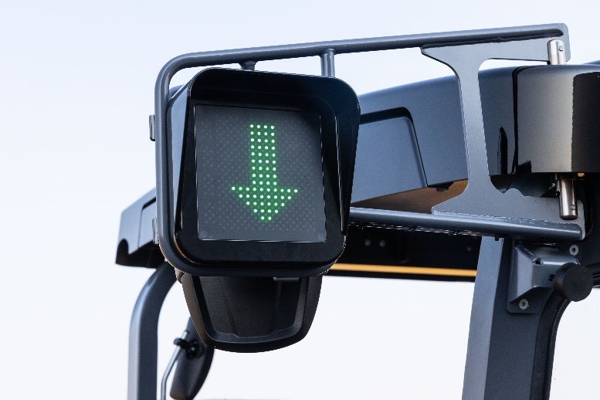
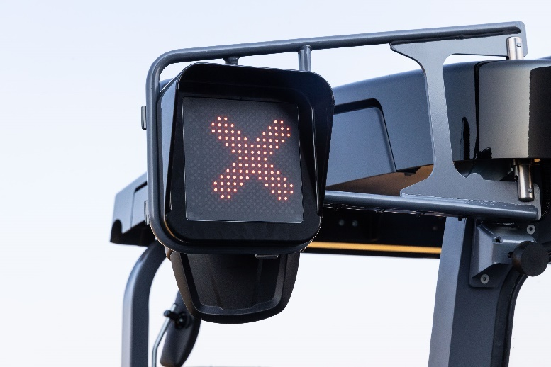
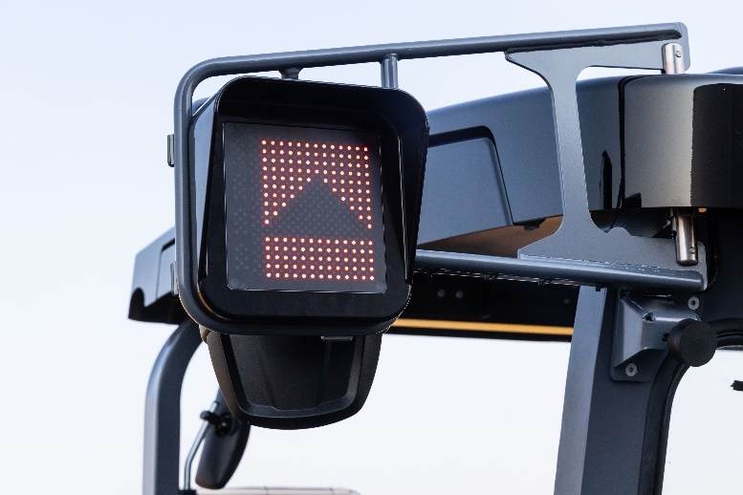
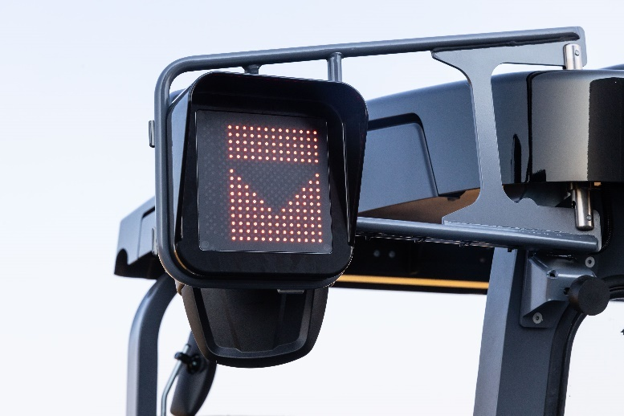

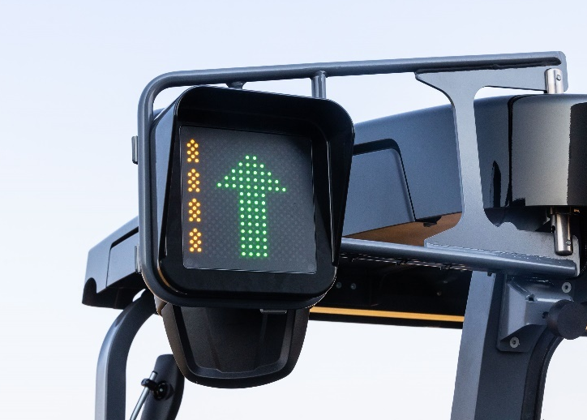
PaveDock Assistant – signal lights
Dock
Stop
Raise dump box
Lower dump box
Drive off
Material feeder moving

Slide 31
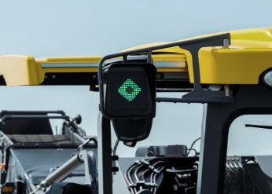

PaveDock Assistant – signal lights
Material feed for the InLine Pave process
With Inline Pave mode activated, a symbol for the corresponding material is displayed as a function of the distance selected.
  Feeding surface course material –
  short distance control set
  Feeding binder material –
  long distance control set
Feed surface course material
Feed binder material

Slide 32
New maintenance and service concept

Slide 33
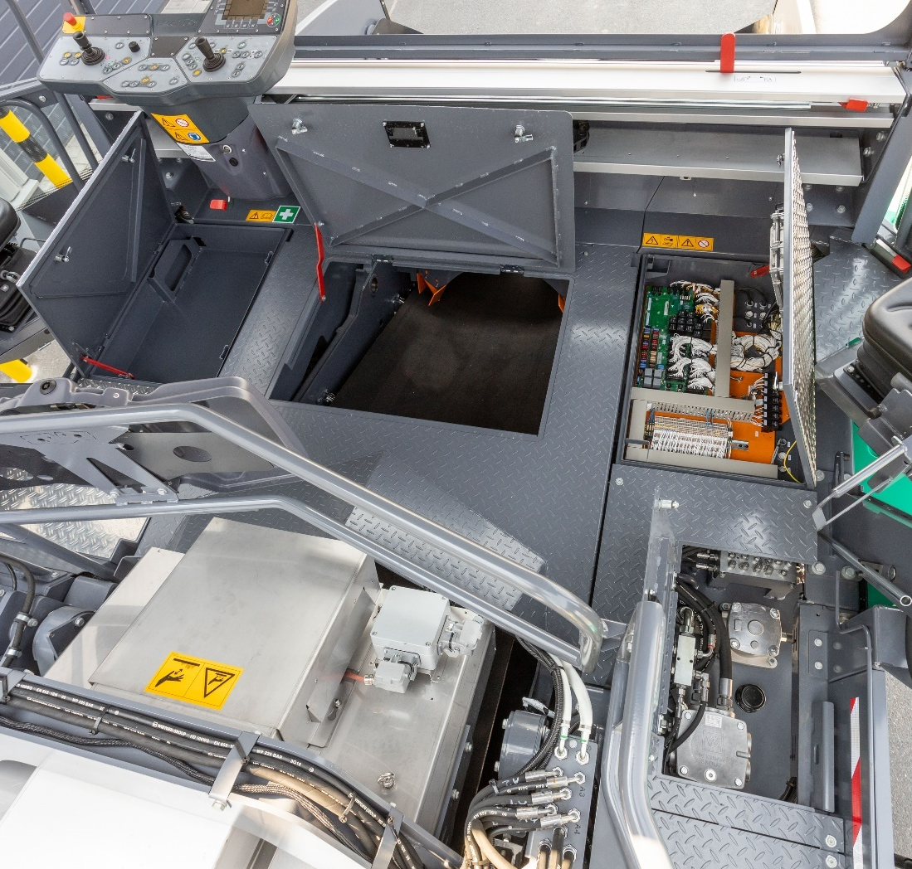
New maintenance and service concept
Quick and easy to maintain
  Maintenance access for the belt, electrical system and hydraulic filter on the operator's platform

Slide 34
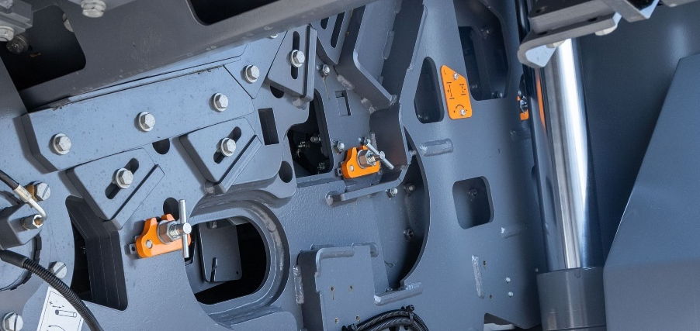
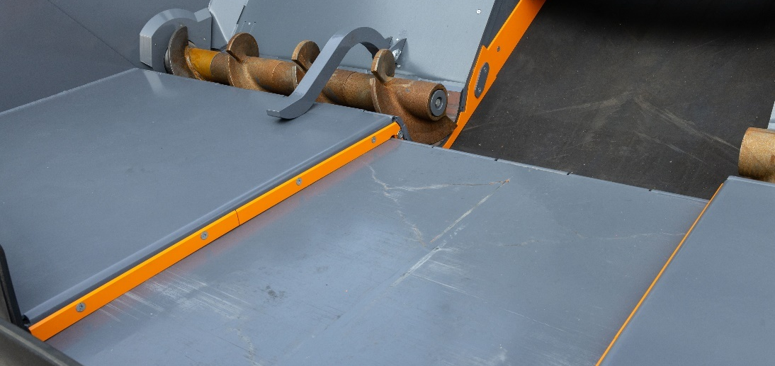
New maintenance and service concept
Quick and easy to maintain
  Relevant setting points are marked in colour
  Simplified settings on the belt and conveyor system
  Better sealing of the material hopper means less cleaning effort

Slide 35
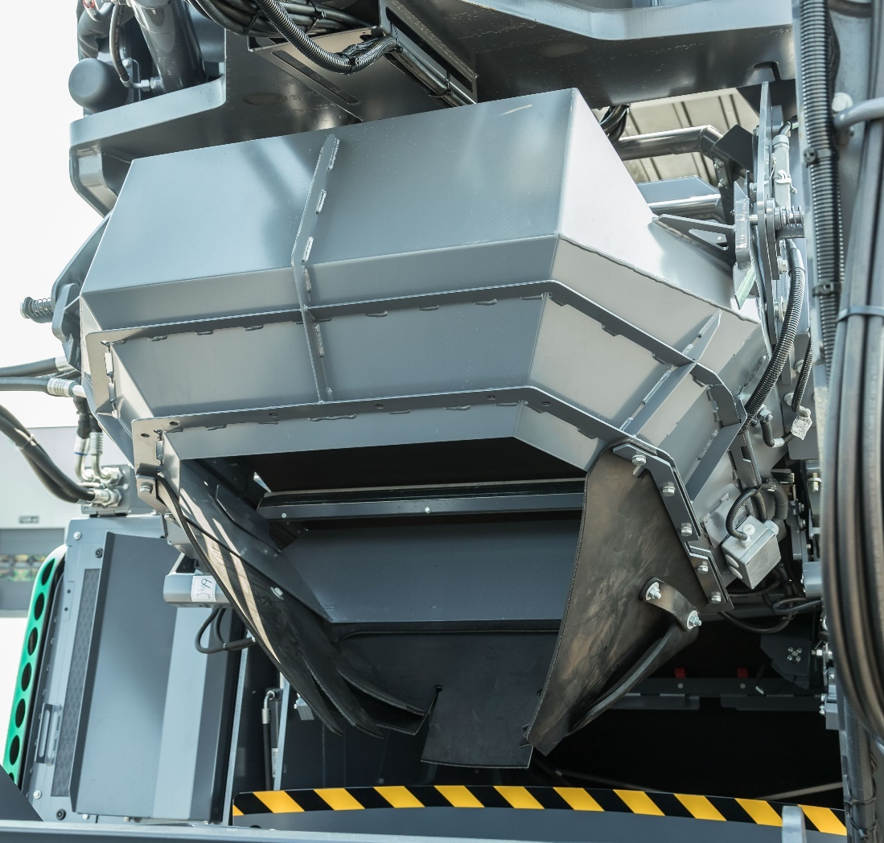
New maintenance and service concept
Specially designed for the MT 3000-3(i) Offset
Transfer hopper from the primary belt to the pivoting conveyor is especially easy to clean:
  good access
  extended step for a steady footing
  hopper is hinged
  machine can be cleaned in its operating position

Slide 36
Use and transport

Slide 37
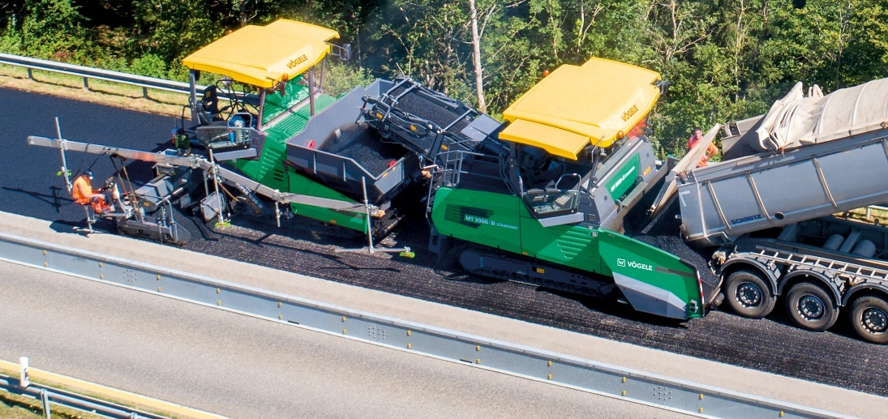
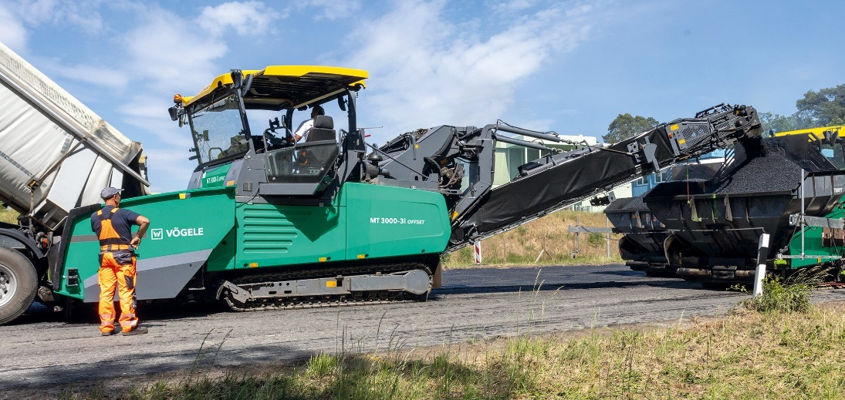
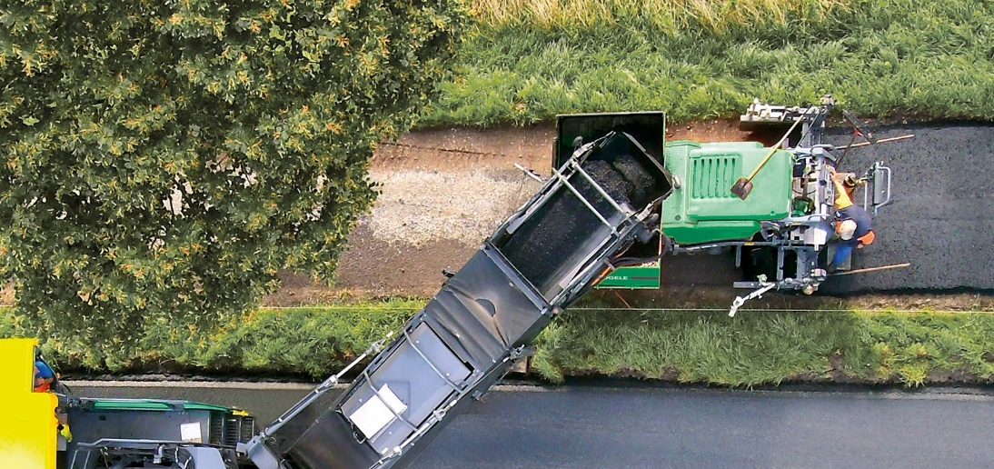
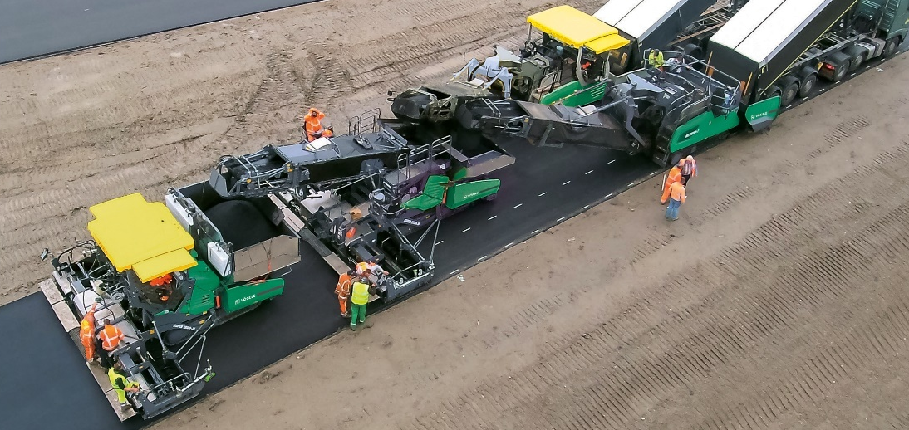
In action
Classic material feed process
Feeding from the side
Feeding Mini Class pavers
Feeding pavers in an InLine Pave train

Slide 38
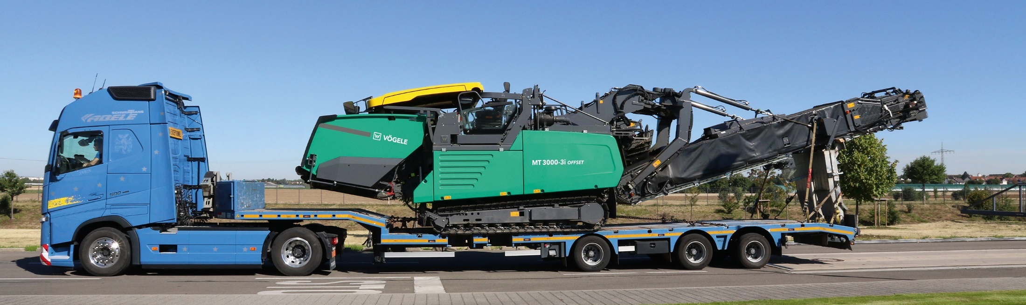
Simple transport of the Offset
  The climbing angle of 15° makes it easier to get up onto low-loaders
  The receiving hopper can be raised and put down on the low-loader
  Optimized transport length

Slide 39


Dimensions and weights
MT 3000-3(i) Standard
  Width: 3,000 mm
  Length: 8,950 mm
  Height: 3,100 mm
  Weight: 19,765 kg
MT 3000-3(i) Offset
  Width: 3,000 mm
  Length: 14,710 mm
  Height: 3,100 mm
  Weight: 24,285 kg

Slide 40

MT 3000-3(i) Standard and Offset
  Engine capacity:
    MT 3000-3: 160 kW
    MT 3000-3i: 142 kW
  Exhaust emissions standards:
    MT 3000-3: Stage 3a; EPA Tier 3
    MT 3000-3i: Stage V; EPA Tier 4
  Pave speed 25 m/min
  Travel speed: 4.5 km/h
  Conveying capacity: 1,200 t/h
  Volume of transfer hopper: 15 t

